Slide 1
Creative Thinking through Programming
Day 1

Slide 2
What’s in your stack yo?

Slide 3
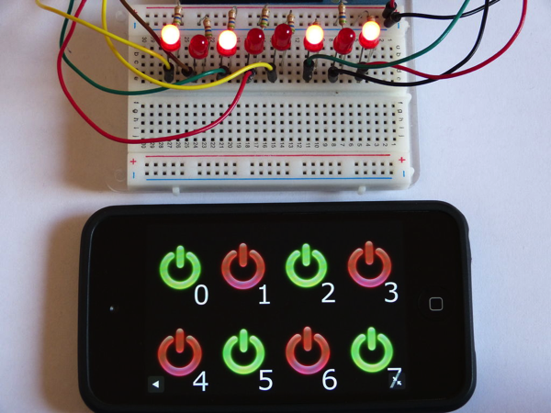
Programming is awesome!

Slide 4
P5 is awesome too! http://p5js.org

Slide 5
AND THEN THERE’S
THE TOOL FOR FOR WHEN YOU GET SERIOUS
Openframeworks.org

Slide 6
This class uses python 2.7.10 and pycharm

Slide 7
Programming is problem solving
Problem solving means the ability to formulate problems, think creatively about solutions, and express a solution clearly and accurately.
How you solve the problem is called the algorithm.
An algorithm is a step by step list of instructions, or a program, that if followed exactly will solve the problem under consideration.
These programs are written in programming languages.

Slide 8
Python
Python is an example of a high-level language (C++, PHP, and Java.)
There are also low level programing languages (assembly, machine language)
High level languages use human friendly sets of instructions to create programs. Low level languages are not as human friendly and are written for the hardware.

Slide 9
Machine language vs High level language
print “hello”
The computer would translate this high language into a low level language for you → 01010101 00011101 00111100
verses writing this yourself
01010101 00011101 00111100
Clearly, high level languages are faster and less prone to error than machine languages

Slide 10
Binary
All low level languages are in binary. Aka a series of 1’s and 0’s. It’s the matrix all over again.
How binary works.
Binary is a series of bits that form 8byte patterns that represent numeric values. Each value represents either on or off. You can think of them like little switches.

Slide 11
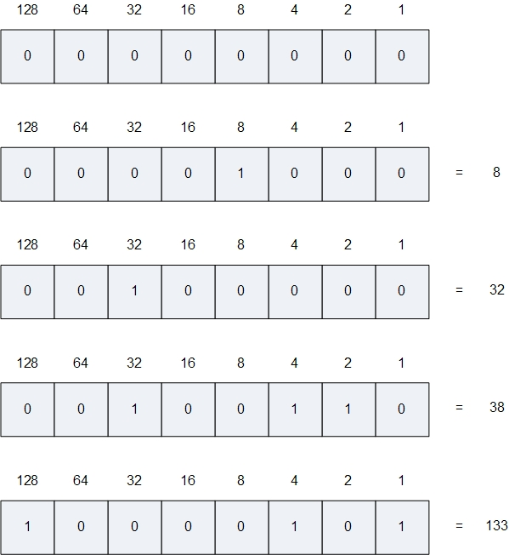
Binary Math
Each bit represents either if it should be counted or not. So 0 = don’t count me. 1 = count me.
00000001 is 1
00000010 is 2
00000011 is 3
00000100 is 4
00000101 is 5
And so on…..

Slide 12
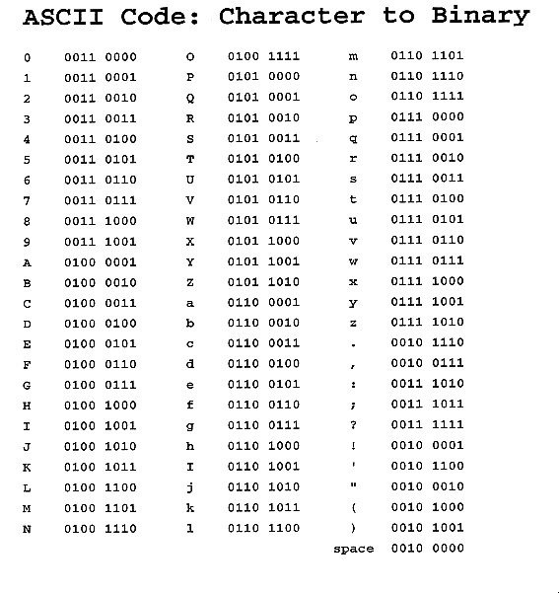
Ascii
Ascii is a way to translate binary into letters and numbers

Slide 13
Unicode
This is kind of the worm hole but…
There’s also Unicode! Unicode is more advanced mapping that allows for far more characters, other languages and so on. It can be 8, 16 or 32 bits.
“an international encoding standard for use with different languages and scripts, by which each letter, digit, or symbol is assigned a unique numeric value that applies across different platforms and programs.”
Unicode is common online.

Slide 14
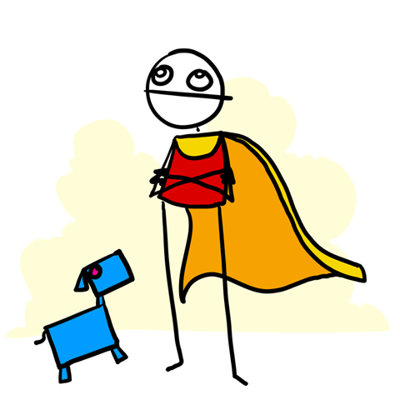
Python!
Python uses Unicode but because it’s higher level. You will almost never, ever think about this.
Where this gets bad is data from the internet but you don’t have to deal with in this class…. If you are lucky, you’ll never have to think this low level.

Slide 15
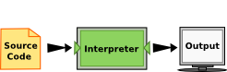
Interpreters & Compilers
An interpreter reads a high-level program and executes it, meaning that it does what the program says. It processes the program a little at a time, alternately reading lines and performing computations.
javascript

Slide 16
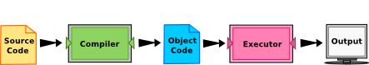
Compilers
A compiler reads the program and translates it completely before the program starts running. In this case, the high-level program is called the source code, and the translated program is called the object code or the executable. Once a program is compiled, you can execute it repeatedly without further translation.

Slide 17
Python does both
Many modern languages use both processes. They are first compiled into a lower level language, called byte code, and then interpreted by a program called a virtual machine. Python uses both processes, but because of the way programmers interact with it, it is usually considered an interpreted language.
There are two ways to use the Python interpreter: shell mode and program mode. In shell mode, you type Python expressions into the Python shell. In program mode you type them into a file.

Slide 18
WHAT IS THIS VOODOO Meet Unix on mac and the command prompt on windows
http://mally.stanford.edu/~sr/computing/basic-unix.html

Slide 19
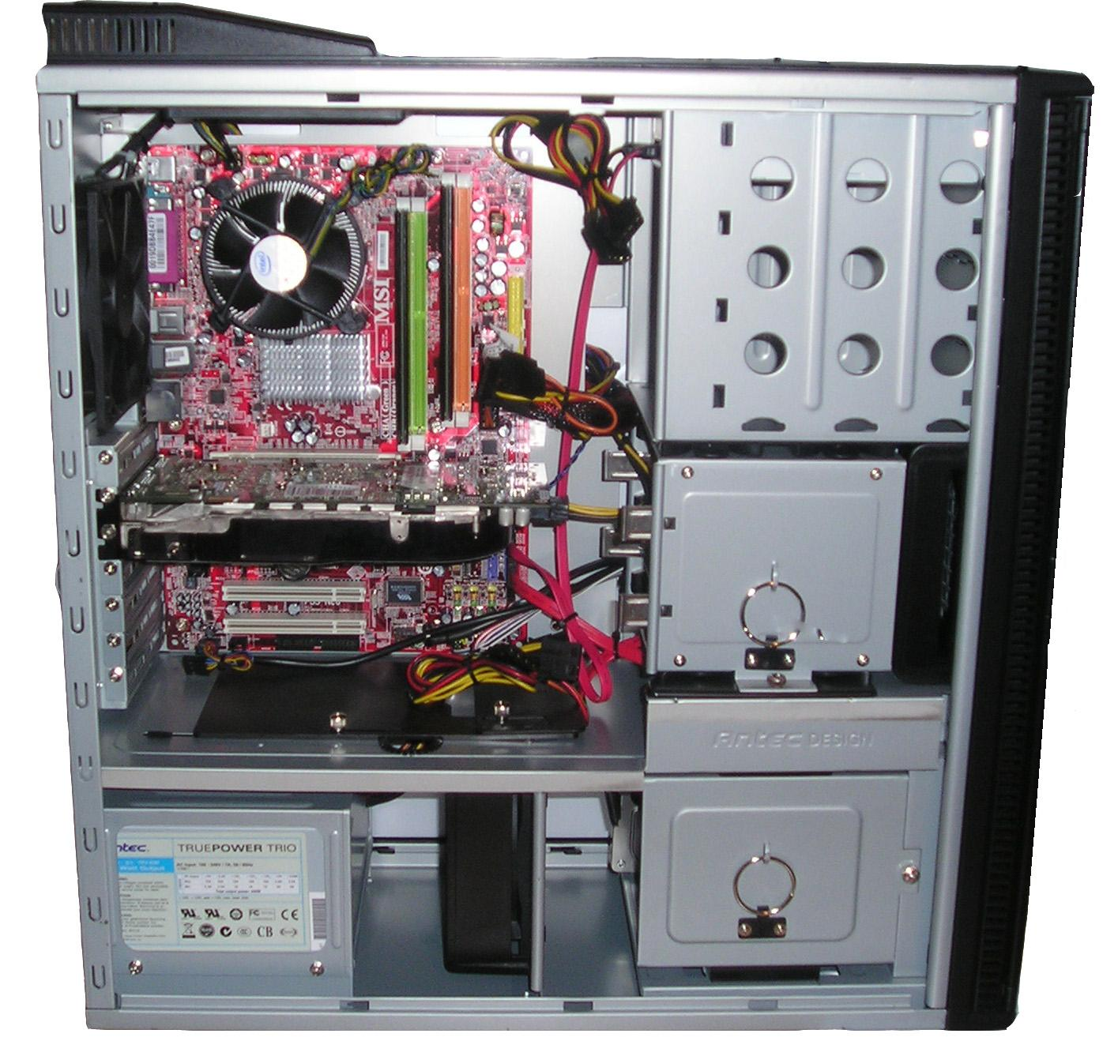
Hardware vs software
Hardware yo!

Slide 20
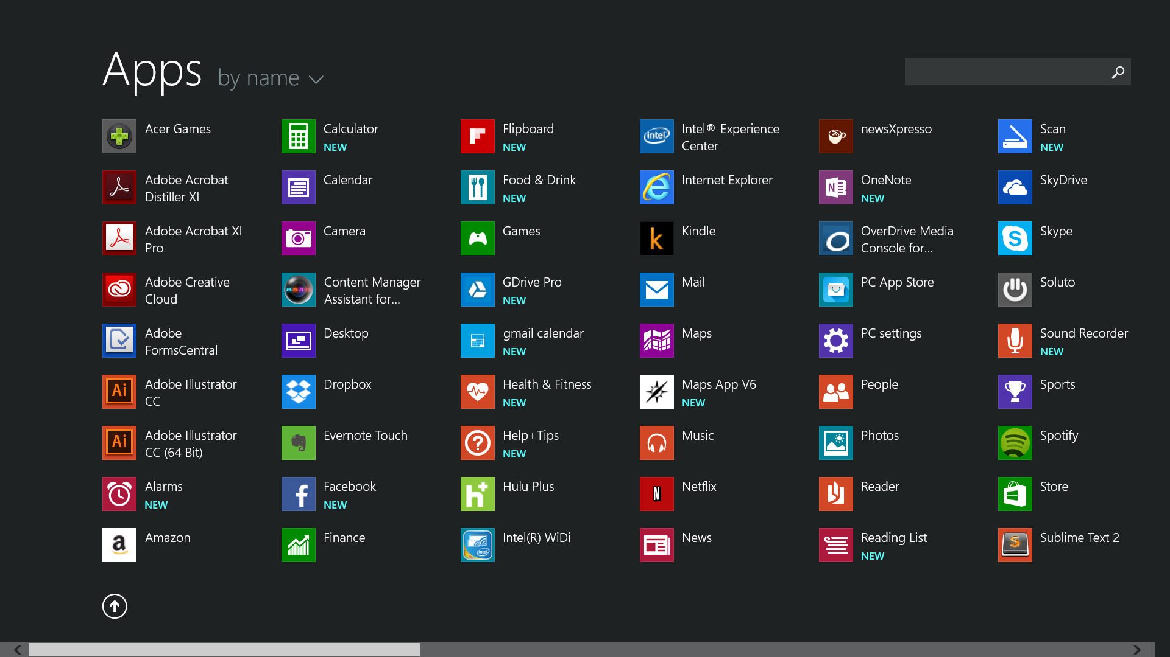
Software
Software yo

Slide 21
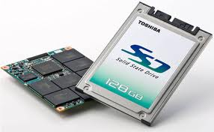
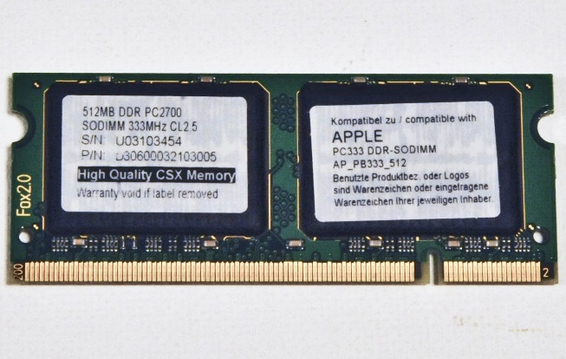
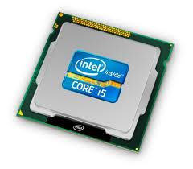
How a program works
A program lives on your hard disk
The instructions of a program get loaded into ram. The machine code is fetched into your CPU
These instructions get decoded and then executed on your CPU

Slide 22
Pycharm
For this class we will be using pycharm and python 2.7
http://www.python.org/
http://www.sublimetext.com/3

Slide 23
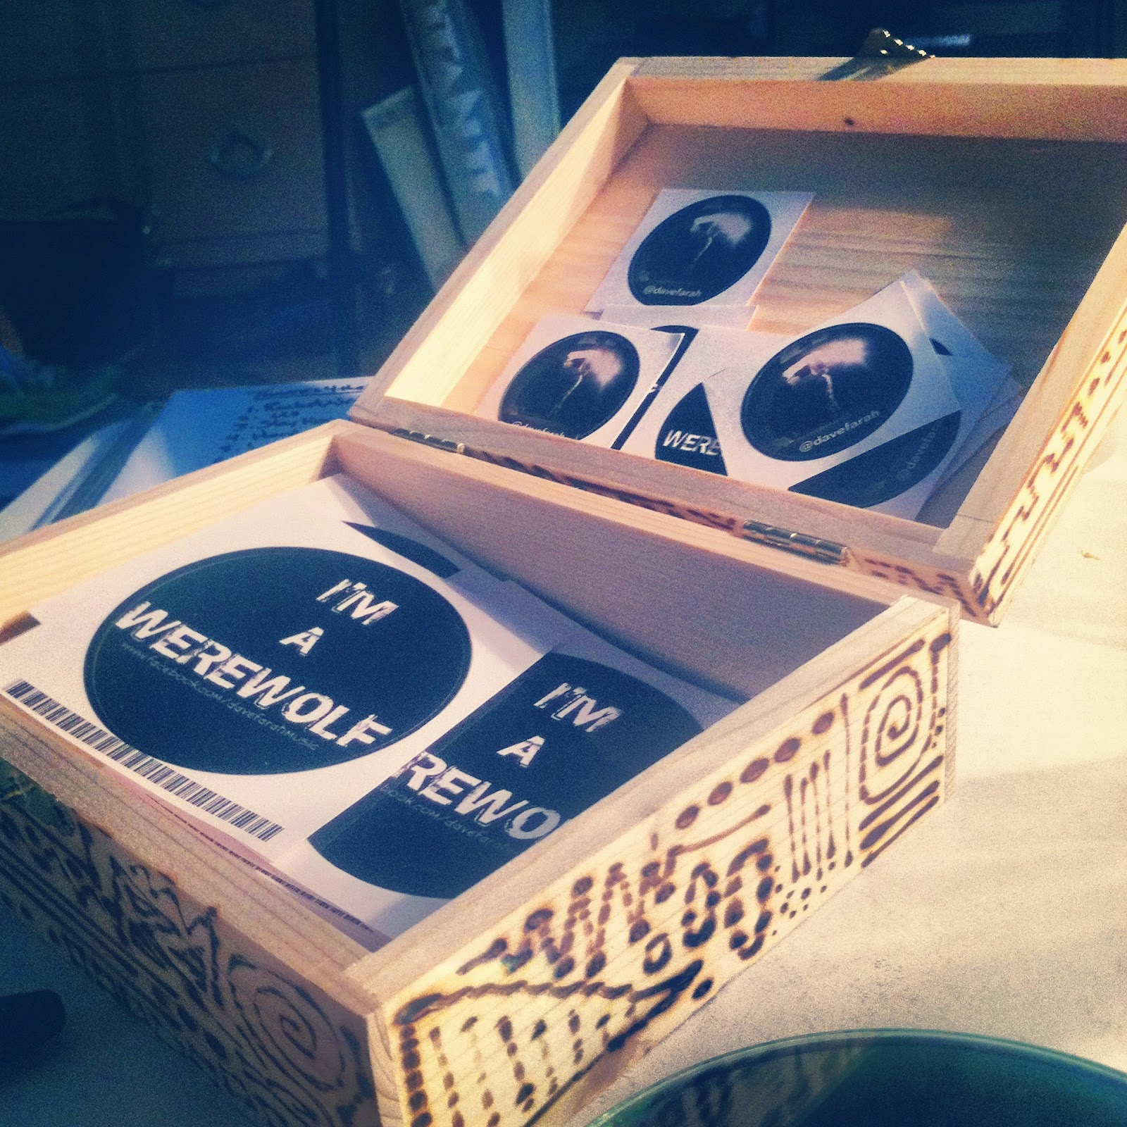
Input variables and output
Variables are types of data stored in containers. Think of them like a box that holds something in it
x = 10
x is the variable
= is the assignment operator and sets the value on the left of the equation to be equal to the variable on the right
10 is the type. It’s an integer number. Or a hole number.

Slide 24
Variables can hold different type of data
These basic or “scalar” types are
Int = 10
Float = 10.0
Boolean = true or false (0 or 1)
None = none… ☺ More on this later
Not Scalar but important
String = “a set of words or characters in quotes”

Slide 25
Special or reserved words (Thou shall not)
Do not put spaces in your file names or variable names
Do not use special characters &!$*+-~,/\%^()
Rule of thumb? Anything that’s not a letter number or underscore is out of the running for a variable name
All variables must start with a letter or an underscore. No numbers first.
Here’s Python’s complete list of reserved words:
False class finally is return None continue for lambda try
True def from nonlocal while and del global not with
as elif if or yield assert else import pass break except in raise

Slide 26
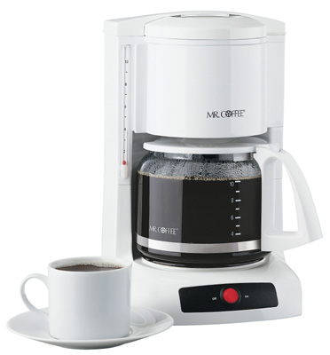
Print something
Print is a function in python. A function is a set of instructions that does something. You sometimes put things into it. Sometimes it returns values.
Functions are like little machines.
I don’t really care how a coffee pot works. All I know is if I put water and coffee grinds into it, it makes coffee and I can take coffee out of it.

Slide 27
Python particulars
You can add numbers using +
You can multiply with *
You can divide with /

Slide 28
Strings
You can also add strings together. This is called concatenation
x = “hello “
y = “ world”
Print x + y

Slide 29
Your lab is at: https://github.com/phoenixperry/hku_python/blob/master/labs/lab_01.md

